Slide 1
BIG MART SALES PREDICTION USING R
Advance Programming Lab
(3CP05)
Presented by
Krupa Patel 20CP301
Prachi vasava 20CP302

Slide 2
PROBLEM STATEMENT
The aim is to build a predictive model to find out the sales of each product at a particular store so that it would help the decision makers at bigmart to find out the properties of any product to store which play a key role in increasing the overall sales.

Slide 3
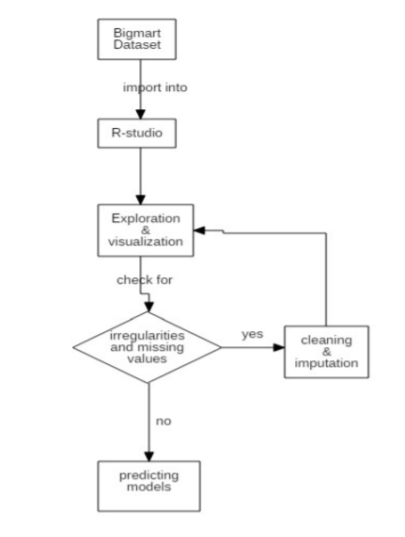
Flowchart

Slide 4
HYPOTHESIS GENERATION
This is very important stage in any machine learning process.
it involves understanding the problem in detail by brainstorming as many factors as possible which can impact the outcome.
It is done by understanding the problem statement thoroughly and before looking at the data.

Slide 5
DATA EXPLORATION
looking at categorical and continuous feature summaries and making inferences about the data.

Slide 6
DATA CLEANING
It involves imputing missing values and treating outliers.
Though outlier removal is very important in regression techniques, advanced tree based algorithms are impervious to outliers.

Slide 7
FEATURE ENGINEERING
We will create some new variables using the existing ones in this section.
Consider combining Outlet_Type
Modify Item_Visibility
Create a broad category of Type of Item
Determine the years of operation of a store
Modify categories of Item_Fat_Content
Numerical and One-Hot Coding of Categorical variables
Exporting Data

Slide 8
MODEL BUILDING
We have implemented linear models for this problem.
Linear regression falls under the category of supervised learning and it is one of the simplest algorithm in the field of machine learning which is used for building the relationship between independent variable(x) and dependent variable(y).
Working algorithm:-
Here we are considering item outlet sales as dependent variable and other variables as independent variable.

